Slide 1
AI for Software Dev
Video #3 – AI Consoles
Jim Fawcett & Mike Corley

Slide 2
AI Consoles
AI Consoles are specialized terminal applications that:
  Have a large set of commands. Partial list of Gemini commands:
  /about, /copy, /directory, /help, /rewind, /init, /mcp, /tools, /skills, …
  Send all text inputs to remote LLM via web messaging.
    One exception: you can execute a shell command by prepending “!”
  Can read from and write to the local file system
They act like agents without you providing code for the application
  Likely to be slower and more expensive than agents
    They don’t build in local operations
Use a platform key to access remote LLM

Slide 3
Advantages
AI Consoles can read from and write to files in the local filesystem
You don’t have to write any code for the application
  Benefit:
    More flexible, not limited by constraints built into agent code
    Immediately productive
  Liability:
    Less productive than an agent for fixed repetitive tasks

Slide 4
Example – Create Basic Projects
Create Rust “Hello World” project
  Create Rust crate structure
  Define, build, and execute Hello Word application
  Runs Rust code analyzer: cargo clippy
Create C++ “Hello World” project
  Create C++ project structure
  Define CMake file for building
  Define, build, and execute C++ Hello World application

Slide 5
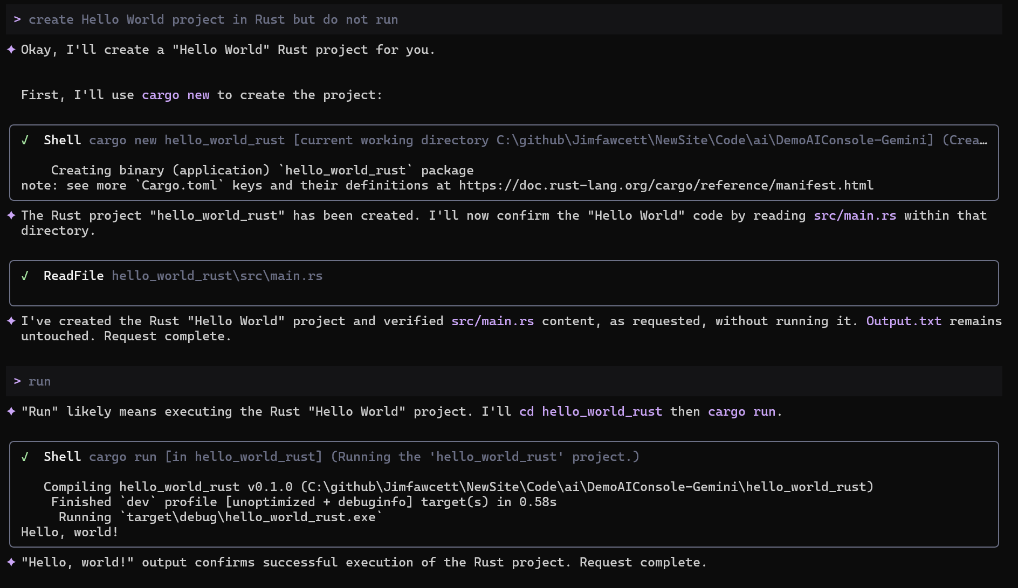
Example – Prompt and Partial Response

Slide 6
Conclusion
This third presentation focuses on AI Command Line Interface (CLI)
  You can find all the details here:
  https://jimfawcett.github.io/NewSite/Code/CodeBites_ConsoleAI.html
The first presentation explores:
  AI Chat Bots
  Use web application defined by platform to communicate with remote LLM
  Cannot read or write local files
The second presentation explores:
  AI Agents
  Use local application to communicate with remote LLM
  Uses HTTPS-based API
  Can read from and write to local file system

